Slide 1


obotics Club
Line Follower Robot
A project brought to you by E-JUST Robotics Club
Instructed by: Mohammad Abdallah

Slide 2

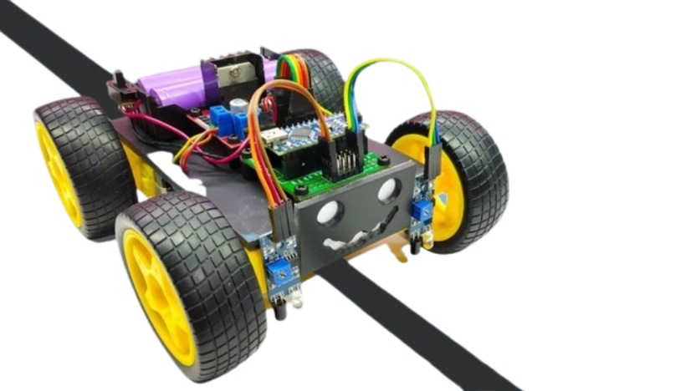
Outline
1
Types of sensors
2
IR
3
Algorithm
4
Code preview

Slide 3
Sensors
Sensor
Classification
Quantity
Power req.
Temperature
Speed
Light
Output signal
Analog
Digital
Active
passive
Device that detects and responds to input from the physical environment
Convert it to electrical signal which will be processed.

Slide 4
Sensors
Active sensor
When you take a picture with the flash turned on, the camera sends its own source of light. After it illuminates the target, the camera captures the reflected light back to the camera lens.
Passive sensor
Cameras are passive sensors when the photographer does not use the flash. Because the camera is not sending the source of light, it uses naturally emitted light from the sun.

Slide 5
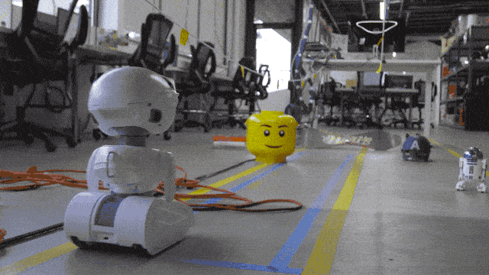
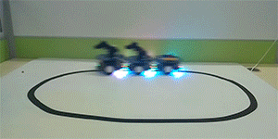
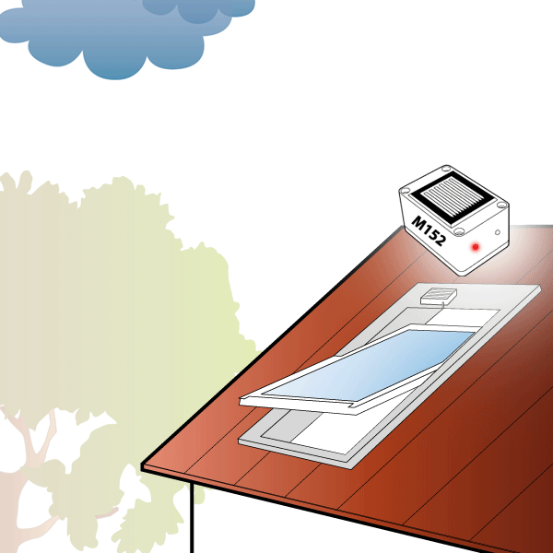
Sensors
Applications:
Obstacle
avoidance
Line follower
Rain detector

Slide 6


What are the output data from the sensor?
Digital
Analog
Analog signals are represented from 0 to 1023
They consist of majorly three components: sensor, cable, and variable resistance
It could be changed to digital signals
Digital signals are represented by 0 or 1 (ON and OFF) also called binary signals
The digital sensor consists of majorly three components such as sensor, cable, and transmitter

Slide 7

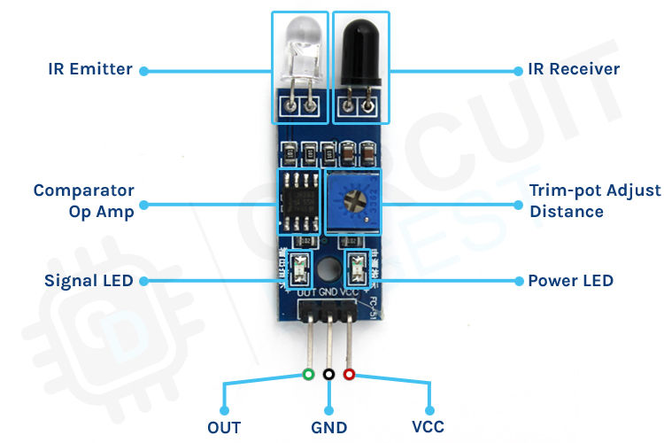
IR Sensor

Slide 8
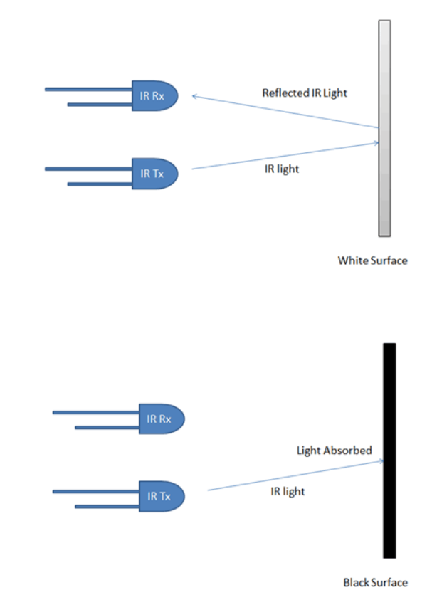
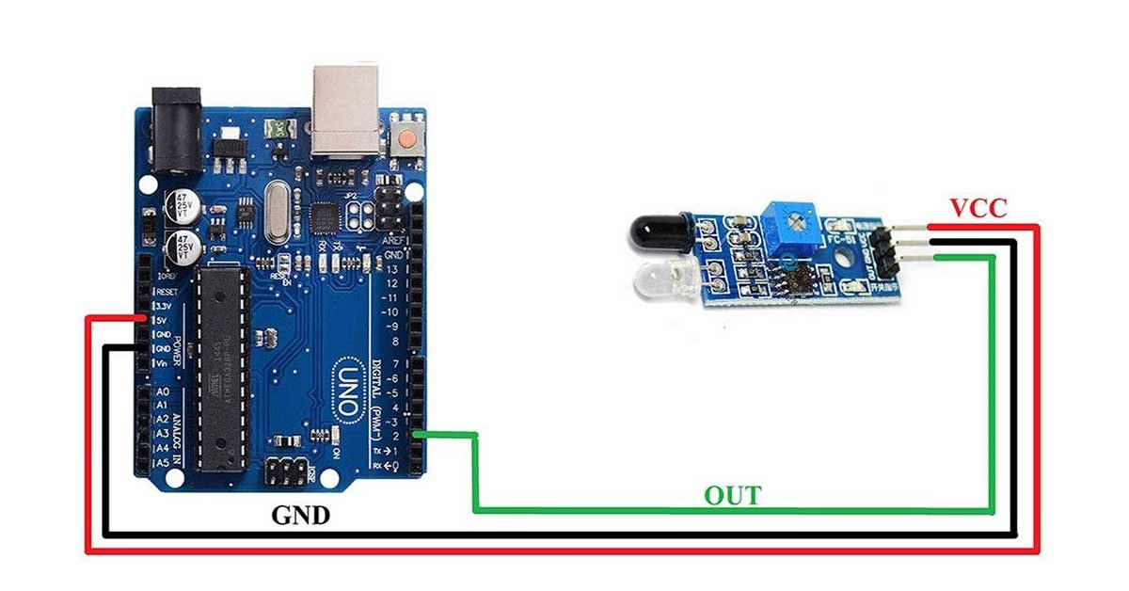

Slide 9
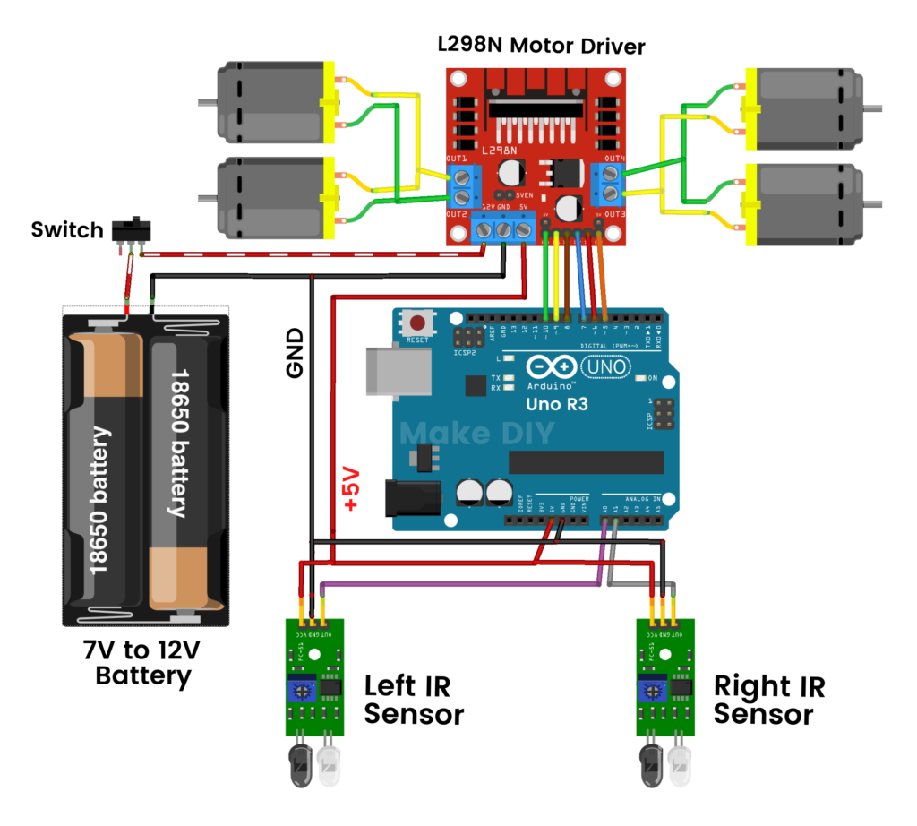

Slide 10
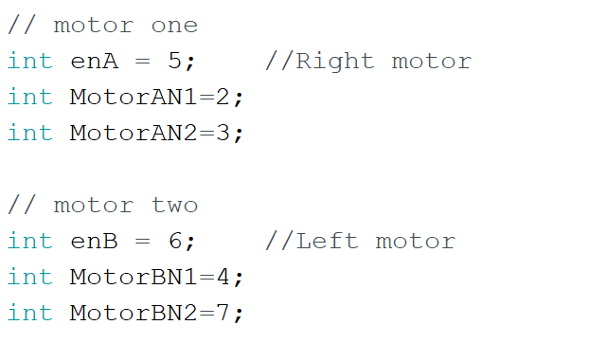

Slide 11
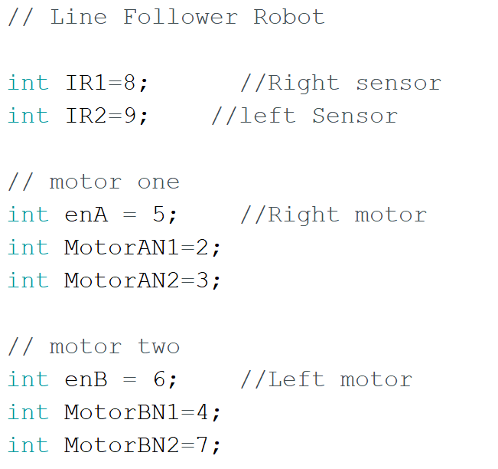

Slide 12
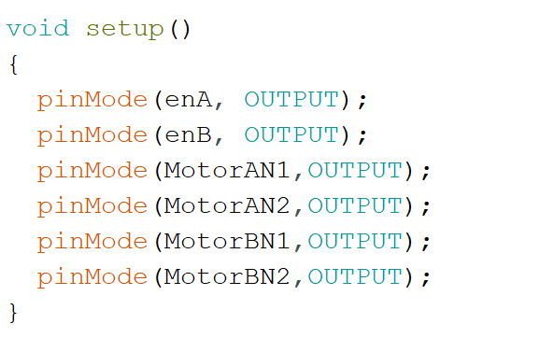

Slide 13
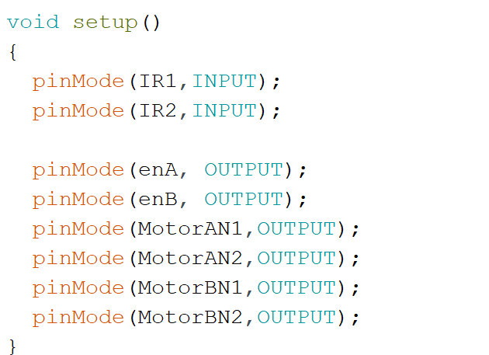

Slide 14

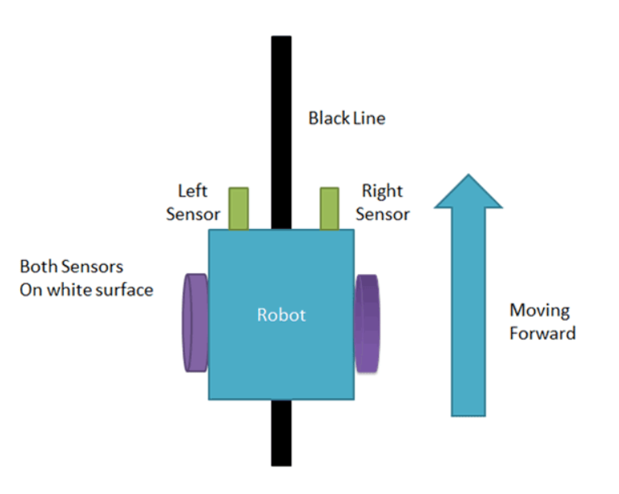
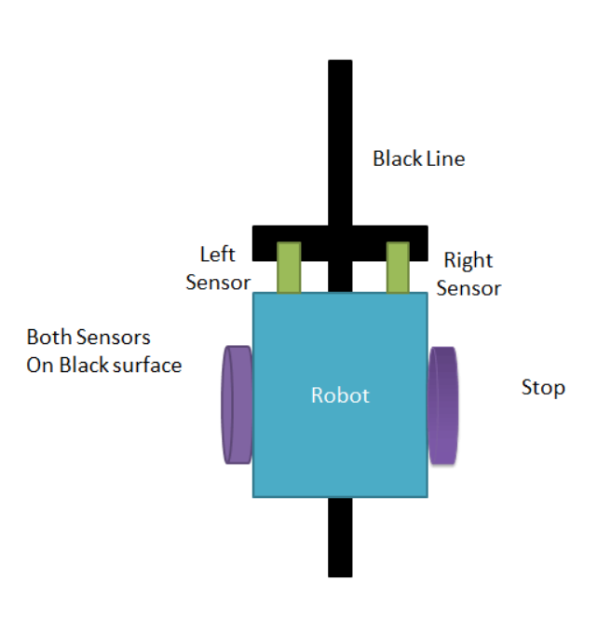

Slide 15
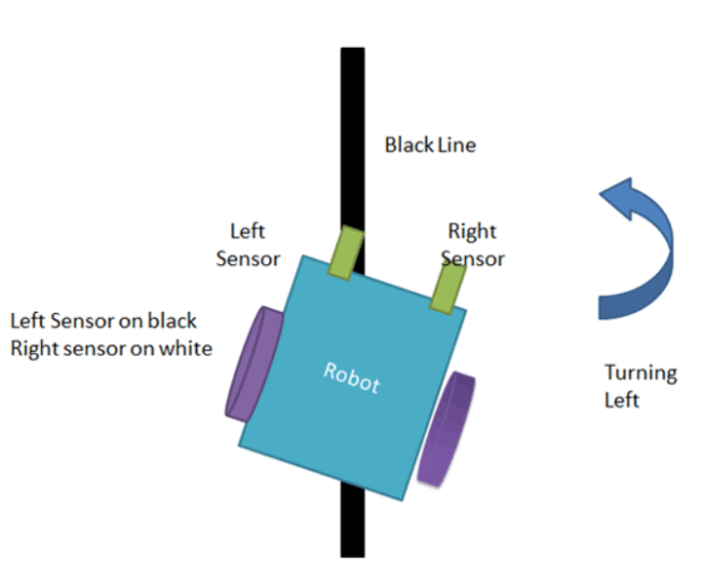
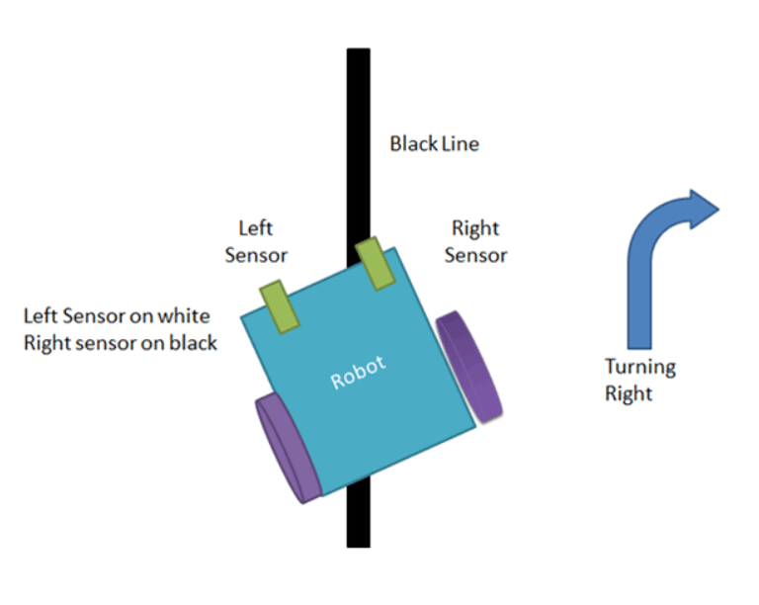
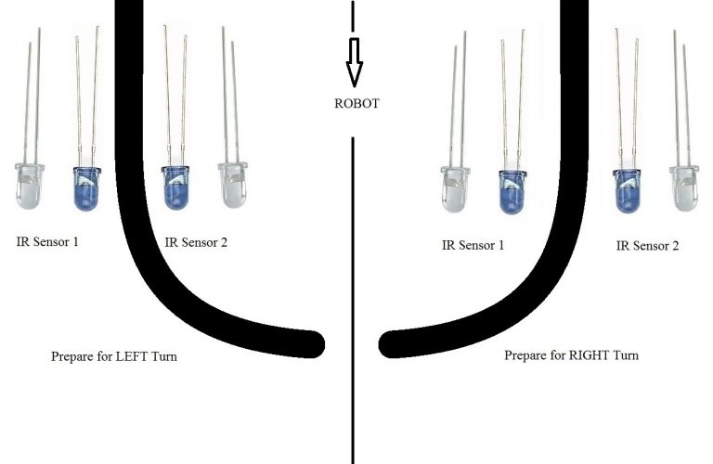

Slide 16
Start
Read Sensors
If Both are White
If Right IR is Black
If Left IR is Black
If Both are Black
No
No
No
Yes
Yes
Yes
Yes
Forward
Right
Left
Stop

Slide 17
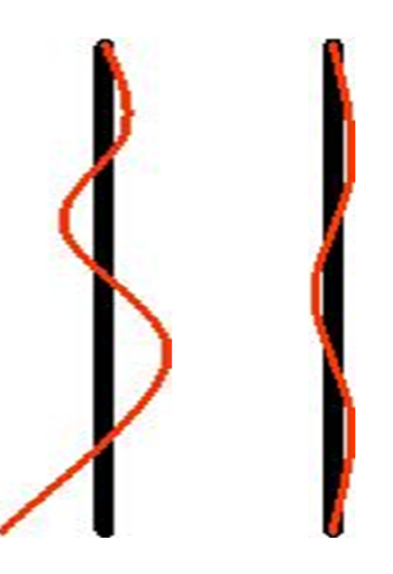
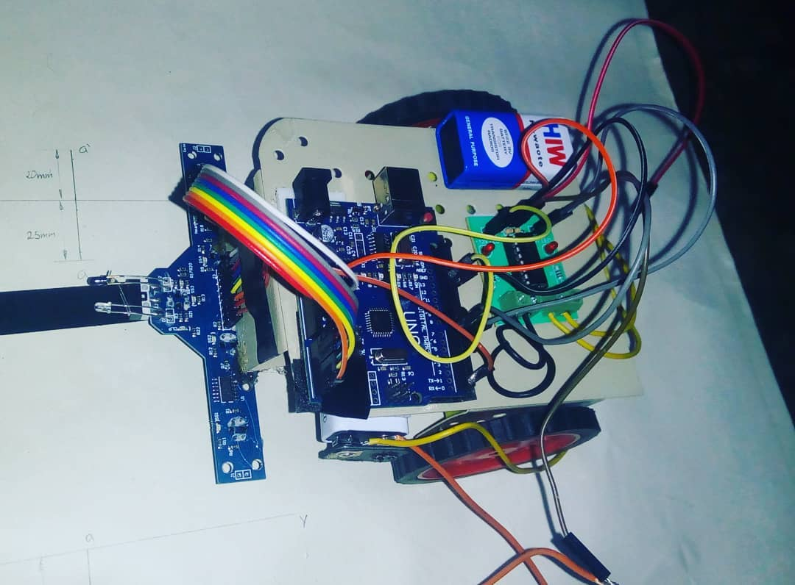
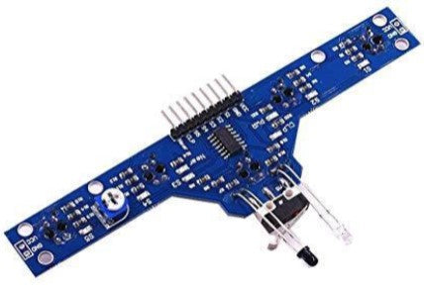
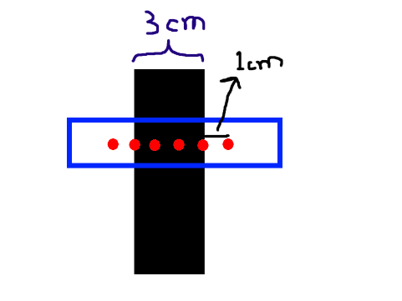

Slide 18
obotics Club
Thank you
https://www.facebook.com/EJUST.Robotics

